Slide 1
Costa’s Levels of Questioning

Slide 2
AGENDA
1. GET YOUR BINDER ORGANIZED!
2. VIEW PEER BINDER POWER POINT
3. COSTA’S PP REVIEW
4. DO 1ST 5 QUESTIONS ON ‘MOVING UP’ Cinderella
5. MINGLE BINGO

Slide 3
What do young children do when they want to know something?
They ask A LOT of questions!

Slide 4
Asking questions about things we don’t know is another way we learn new information
The higher the level of question, the higher the level of thinking and understanding you achieve.

Slide 5
In AVID, we will be developing higher level questions for Cornell Notes, tutorials and Socratic Seminars
It’s true, there is no such thing as a bad question, but some are definitely better than others.
We want to use questions that require some serious brain activity!!!

Slide 6
There are three levels of questions and “academic vocabulary” you should be familiar with.
LEVEL III
LEVEL II
LEVEL I

Slide 7
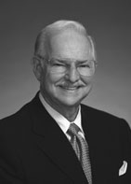
Arthur Costa
Educational researcher
Divided questions into three categories depending on the quality of the question.
If we learn to use these categories, we’ll become better thinkers.

Slide 8
What’s the big deal?
Learning takes place when you produce knowledge not reproduce it.
Recognize a higher-level thinking question: Colleges want you to be able to dig deeper, use higher level thinking questions.
Needed for Cornell Notes, Tutorials and Socratic Seminars…so we can have a common language

Slide 9
FACTUAL QUESTIONS:
have only one answer
answers found RIGHT in the text
info is recalled in the exact manner/form it was heard
short answers (usually 1 or 2 words)
LEVEL I

Slide 10
Gathering and recalling information:
Level I questions start with:
define, describe, identify, list, name observe, recite, scan, explain, locate, paraphrase
LEVEL I

Slide 11
How old was George Washington?
What is your name?
These are NOT the kind we will use. Don’t waste everyone’s time w/these type of questions.
LEVEL I

Slide 12
INTERPRETIVE QUESTIONS
more than one possible answer w/evidence from the text
more abstract, one must manipulate or use the information from the text to find the answer
involves finding info. that supports generalizations or decision-making
Short answer or essay
LEVEL II

Slide 13
Making sense of the gathered information:
Level II questions start with:
analyze, compare, group, infer, contrast, sequence, illustrate, retell, synthesize, sort, diagram, summarize
LEVEL II

Slide 14
What is unique about you?
These questions require you to think a little harder!!!!!
LEVEL II
Compare George Washington to John Adams. Who was a better leader?

Slide 15
EVALUATIVE QUESTIONS
answer goes beyond text
applying information
answer depends on personal experiences, values, interpretation of literature, etc.
asks for judgments to be made from information
gives opinions about issues, judge validity of ideas
Essay questions
LEVEL III

Slide 16
Applying and evaluating information:
Level III questions start with:
apply, evaluate, hypothesize, imagine, judge, predict, speculate, compose, construct, critique
LEVEL III

Slide 17
These questions require you really think, reflect, and write!!!
What is your favorite band and why?
Do you agree that all athletes should be drug-tested?
LEVEL III
Evaluate each character to determine who suffered the most?

Slide 18
Real learning takes place in levels II and III.
LEVEL III
LEVEL II
LEVEL I

Slide 19
REVIEW:
Applying and evaluating information
LEVEL III
Make sense of the information
LEVEL II
Gather and Recall information
LEVEL I

Slide 20
Ready for some questions a teacher might ask….

Slide 21
2
To which level do these words belong?
____1). Sequence
____2). apply
____3). analyze
____4).list
____5).hypothesize
____6). describe
____7). recite
____8). compare
3
2
LEVEL III
1
3
LEVEL
II
1
1
LEVEL I
2

Slide 22
1
____9).Describe your study habits from last year.
____10). Generalize how a successful AVID student
should study.
___ 11). Predict how your study habits from last
year will have an impact this year.
__12). Infer will happen this year if you
study the same way as you did last year.
___ 13). Illustrate the story.
__14). Imagine if you didn’t study…..
3
3

Slide 23
____15).How does the poem begin?
____16). In your opinion, which of the characters
suffered the most?
____17). Contrast a lawyer and doctor.
____18). Which states seceded from the union?
____19). How does the character’s violence reveal
a deep-rooted insecurity.
____20). Using this equation, how can we find out the number of apple trees in an orchard having 15 rows, 5 trees each.
1
3
2
1
2
3

Slide 24
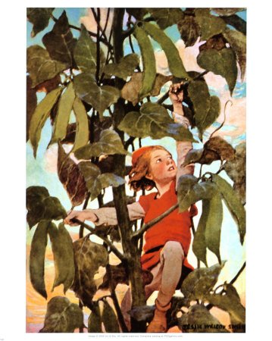
Let’s try a fairy tale!

Slide 25
____1).How would you feel if you were the Giant?
____2). Retell the story in your own words.
____3). What did Jack trade for the beans?
____4). What is the moral of the story?
____5).What did Jack find at the top of the stalk.
____6). How is Jack’s personality like yours?
____7). How is this fairy tale similar to Cinderella?
____8). How would you solve a similar problem?
3
2
1
2
1
2
2
3

Slide 26
Now it’s your turn to write some questions of your own.

